Slide 1
4W MARKETING AND ADVERTISING SOLUTIONS, INC.

Slide 2

WHAT
WHO
WORK
WHY
THE 4Ws OF 4W

Slide 3
WHO WE ARE
Well-informed.
Willing.
Without limits.
Within reach.

Slide 4

WHO WE ARE
YOUR BUSINESS PARTNER
bridge
your
needs of the
strategies
consumers

Slide 5
Our vision is to be a world-class, globally-recognized marketing and advertising company, delivering services of the highest caliber as one of the preferred suppliers of FMCG companies worldwide.
Our service-driven mission is to work with our client partners and provide effective solutions to your marketing and advertising needs because
your goals
ARE OUR GOALS

Slide 6
Furthermore, our core values define who we are and how we work.
CLIENT FOCUS
TEAMWORK AND COLLABORATION
RESPECT FOR THE INDIVIDUAL
Your goals are our goals
Bringing great minds together
We value our people and our clients
CREATIVITY
PASSION FOR EXCELLENCE
INTEGRITY AND TRUST
Finding new, specific, and effective solutions
Commitment to provide the best service
You can count on us

Slide 7
WHY WE’RE HERE
We are here to work
WONDERS
In places that matter
for the people who matter

Slide 8



effective
well-thought
strategy
solutions
significant
results

Slide 9
WHAT WE DO
Event Concepts &
Management
Corporate Giveaway &
Premiums
Brand & Product
Activation
Printing &
Installation
Fabrication
Manpower
Services
Merchandising &
Product Displays
Manpower Training &
Development
Creative Design &
Concept
Notes:
Consider restructuring featured products and services – arrange from “small-scale” to “large-scale” projects in terms of significance / what most businesses require from a supplier
Creative Design & Concept – affects all facets of most projects that require production of any sort
Fabrication – also affects most projects that require production
2.1. Merchandising and product displays – booths, in-store modules, etc. – most FMCG and non-FMCG businesses will be familiar with these items
2.2. Printing and Installation – common requirement for most businesses
2.3. Corporate Giveaways & Premiums – another common requirement for most businesses
Event Concepts & Management
3.1. Brand & Product Activation
Manpower Services
4.1. Manpower Training & Development
4.2. Jobber / Selling Program

Slide 10
COVERAGE
MODERN TRADE
GENERAL TRADE
WHOLESALERS
SPECIAL ACTIVATIONS
CORPORATE

Slide 11
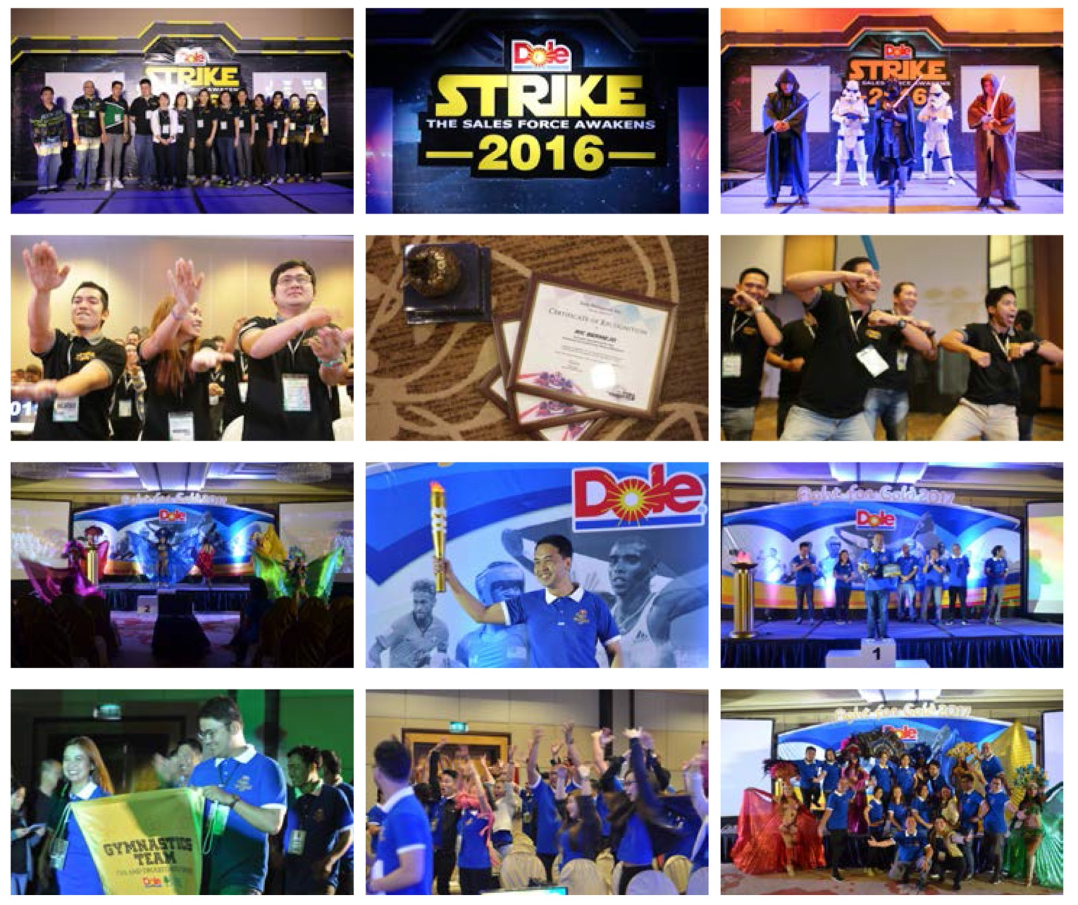
Event Concepts and Management Dole National Sales Conference (Feb 2016 & 2017)
WORKS
Notes:
Replace some pictures – tech booth
Corporate events
Including scriptwriting, video editing, screenshot on AVP

Slide 12
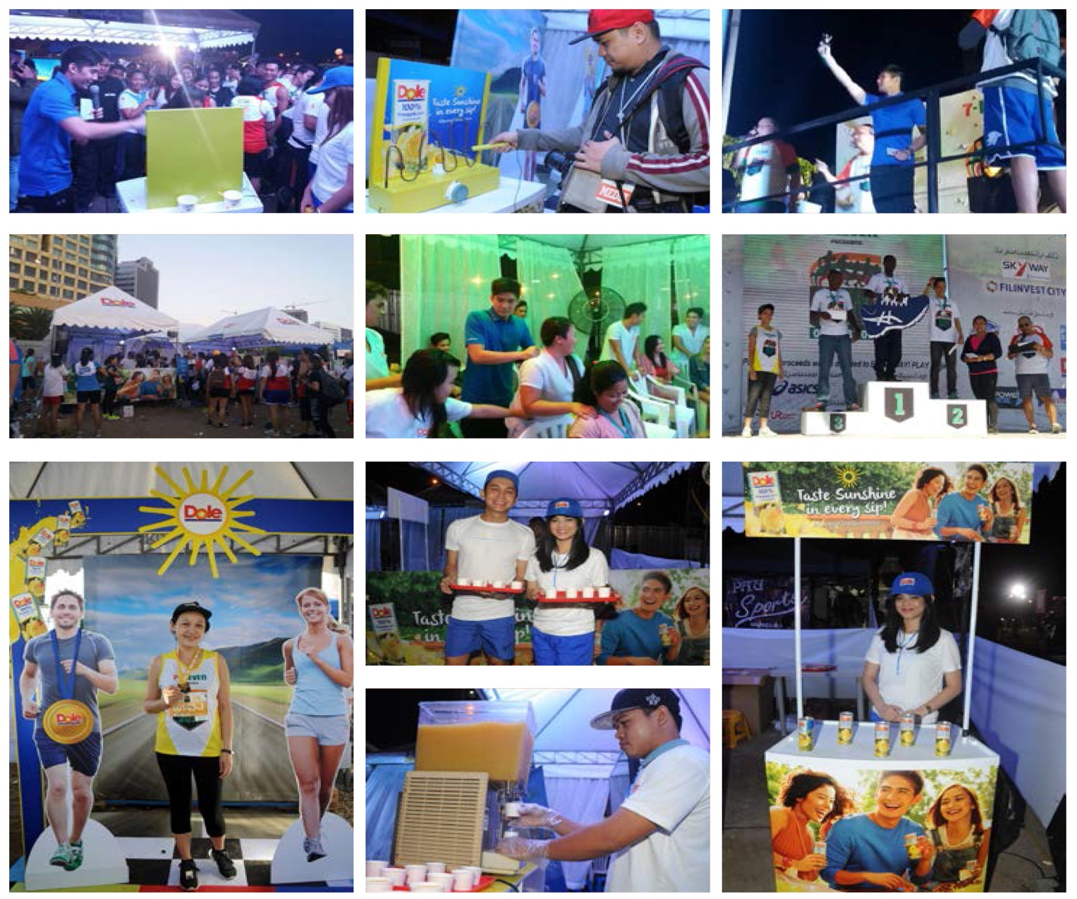
Event Concepts and Management Dole 7-Eleven Fun Run (Feb 2017)
WORKS
Notes:
Replace some pictures – tech booth
Corporate events
Including scriptwriting, video editing, screenshot on AVP

Slide 13
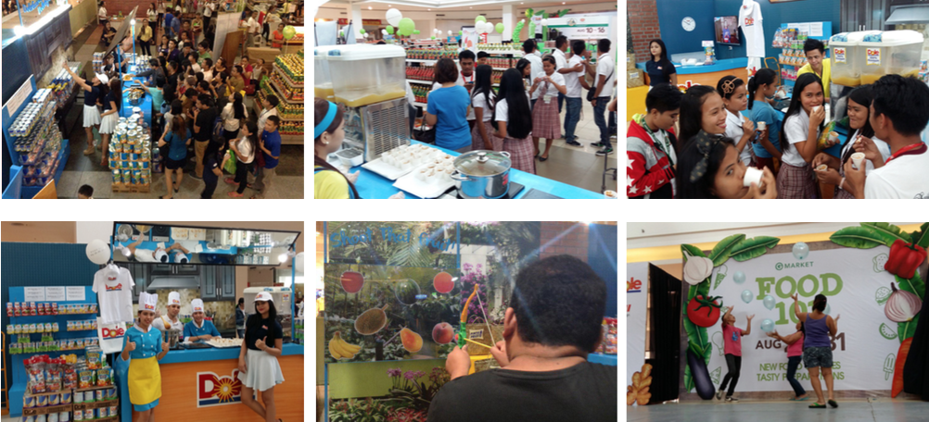
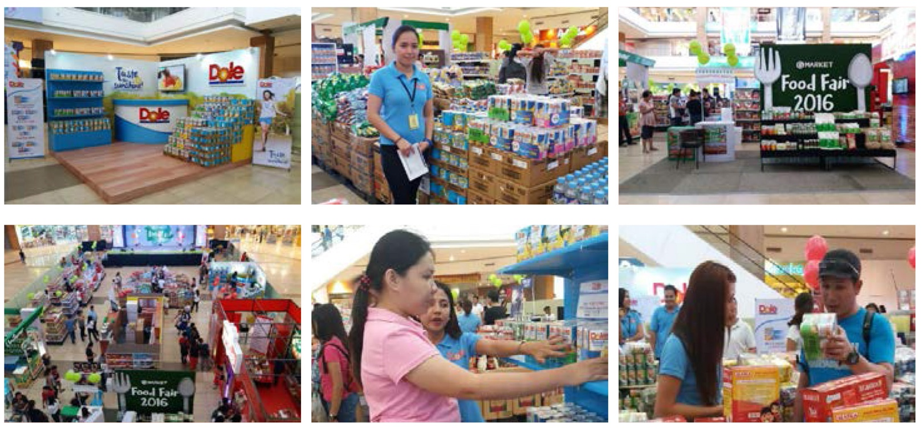
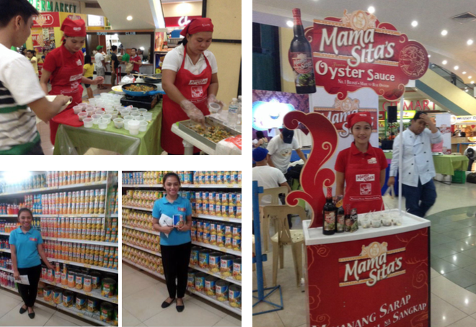
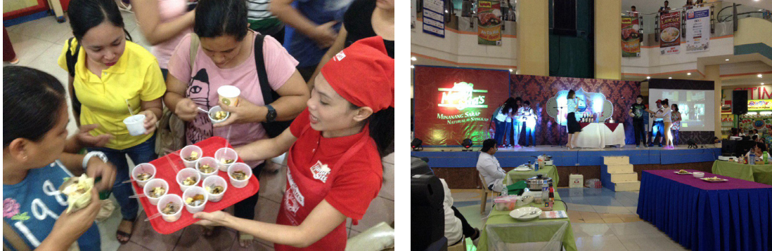
Event Concepts and Management Dole Gaisano Food 101 & Food Fair (Aug 2015 & 2016)
WORKS
Notes:
Replace some pictures – tech booth
Corporate events
Including scriptwriting, video editing, screenshot on AVP

Slide 14
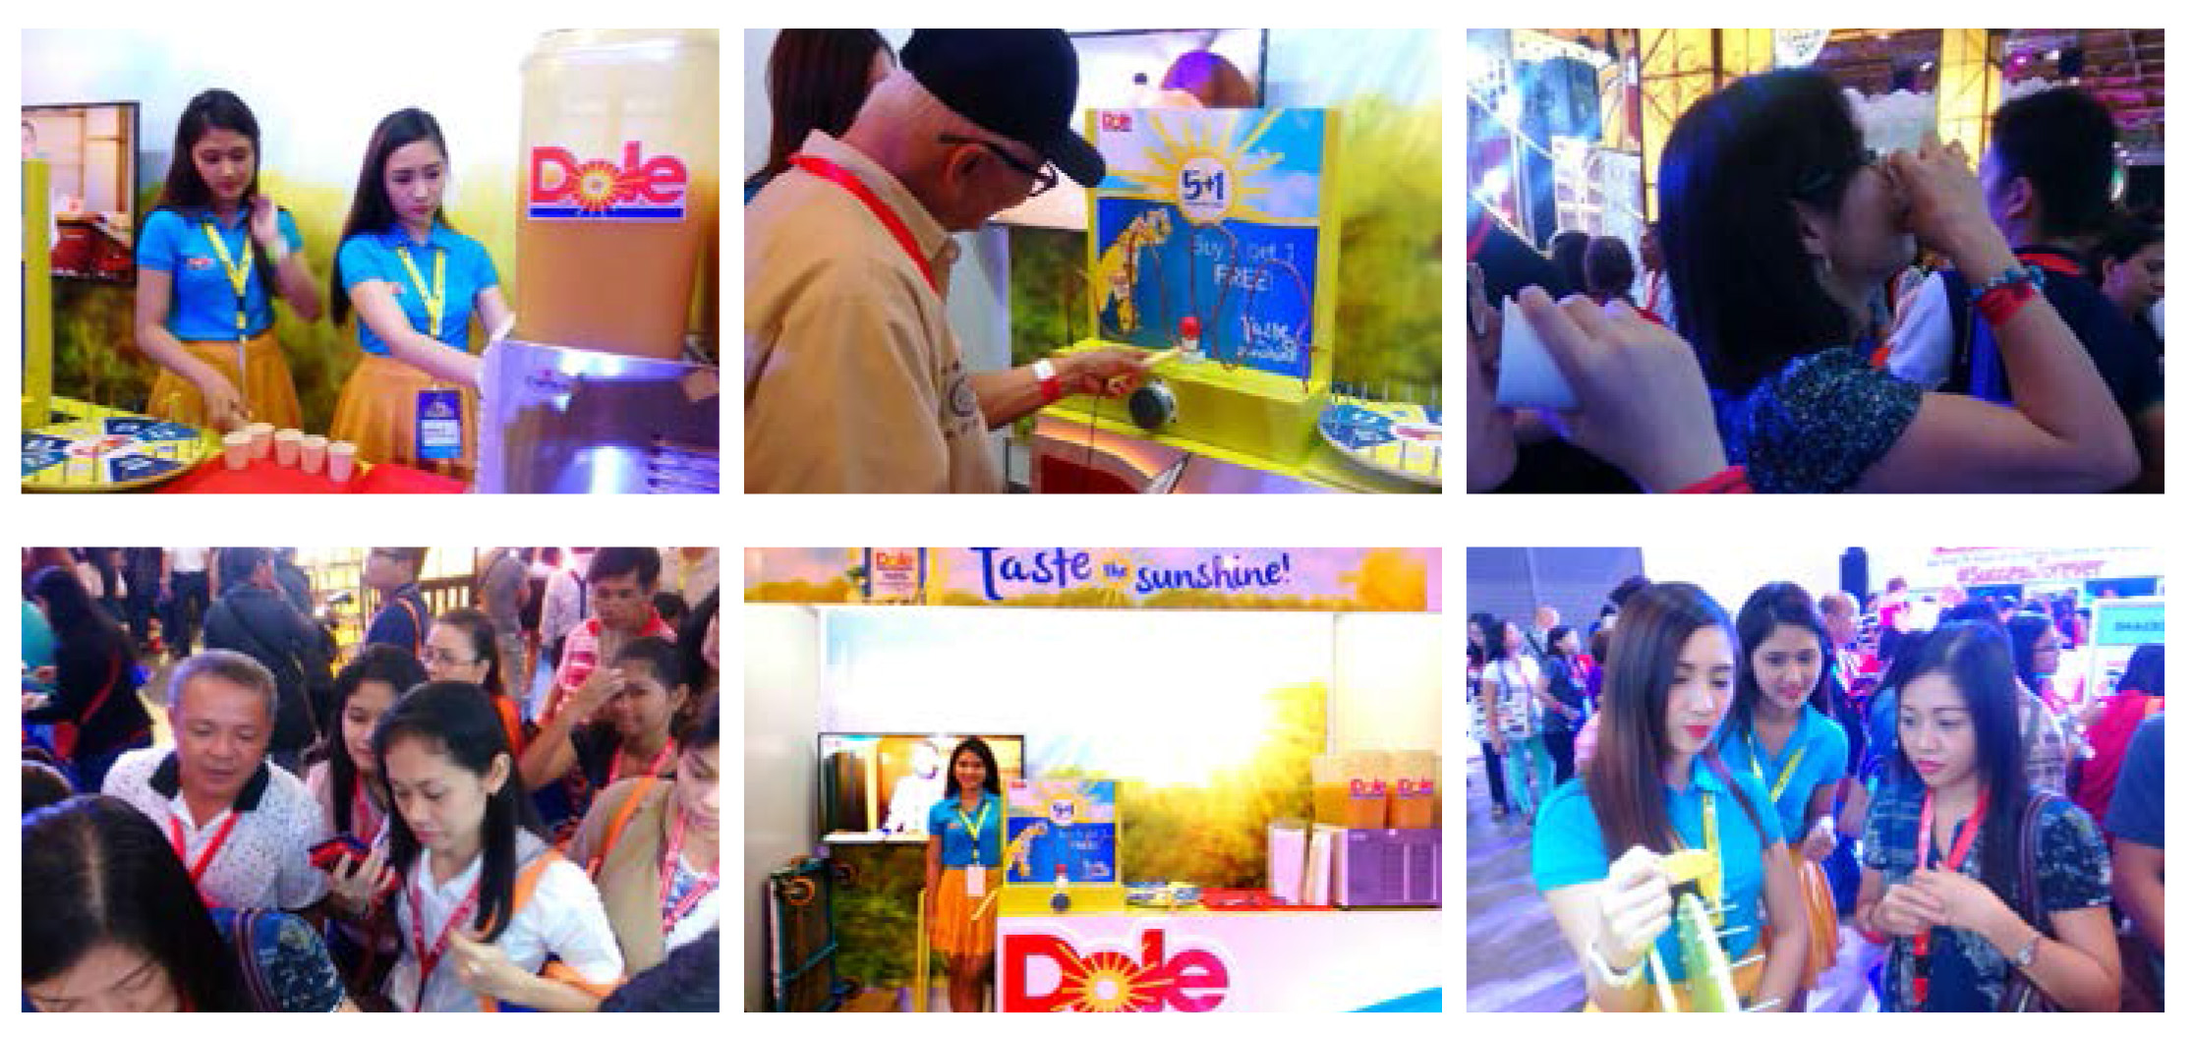
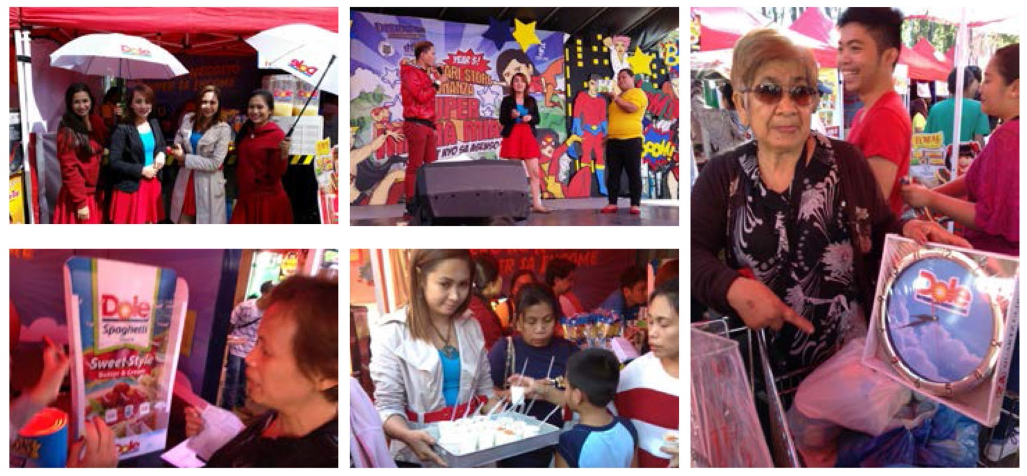
Event Concepts and Management Dole Suy Sing Suki Day (June 2016)
WORKS
Dole Tiongsan Convention (Nov 2015)
Notes:
Replace some pictures – tech booth
Corporate events
Including scriptwriting, video editing, screenshot on AVP

Slide 15
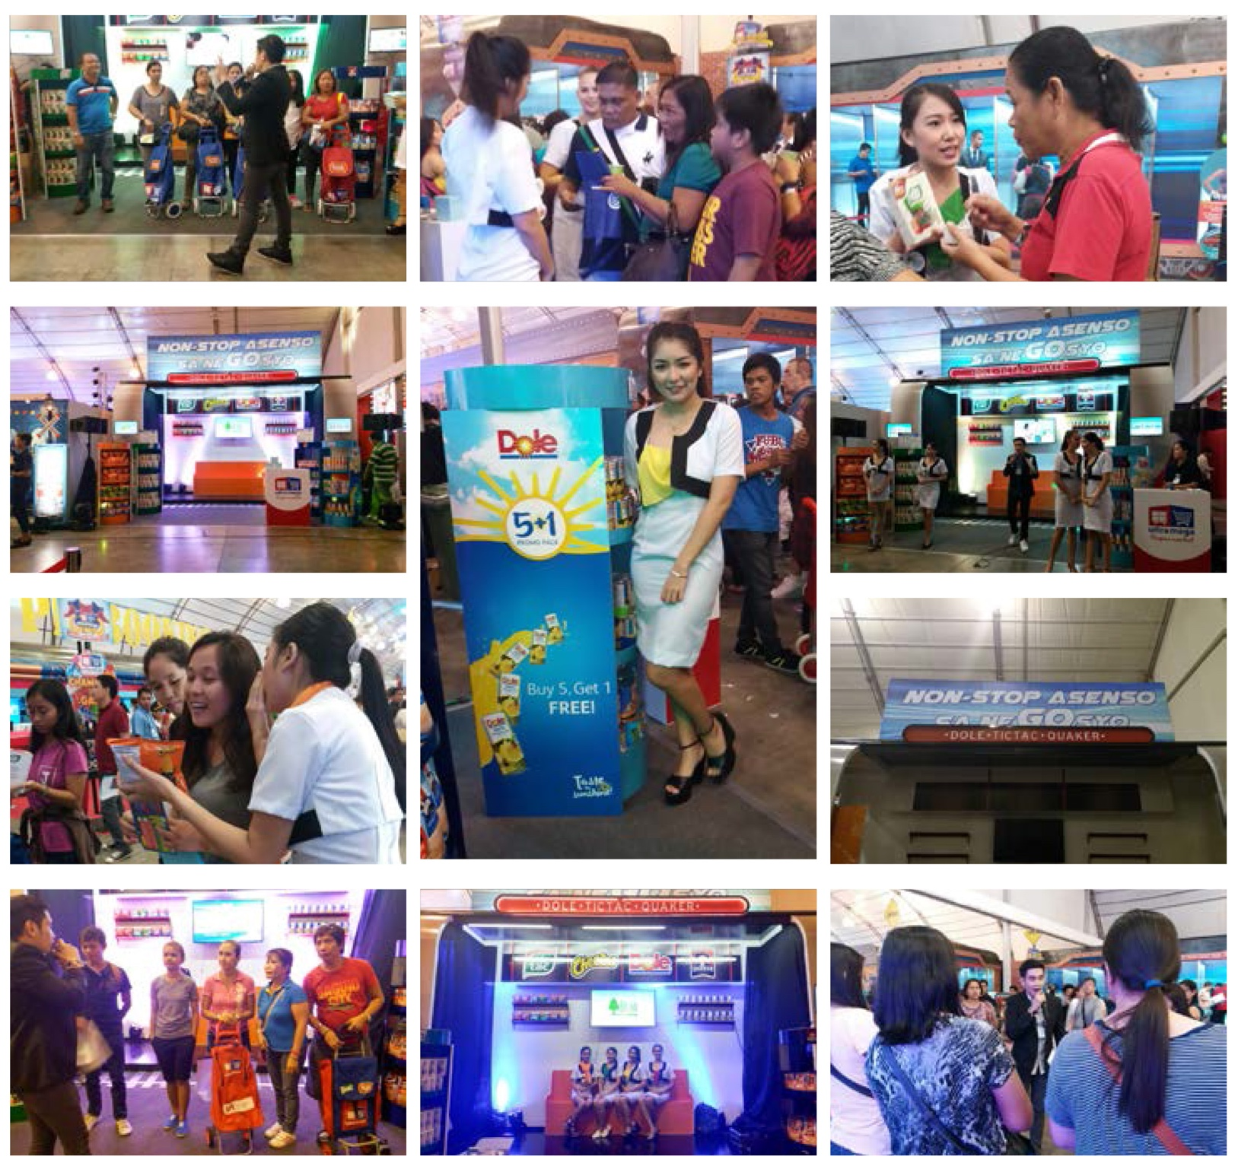
Event Concepts and Management Benby UltraMega Convention (Oct 2016)
WORKS
Notes:
Replace some pictures – tech booth
Corporate events
Including scriptwriting, video editing, screenshot on AVP

Slide 16
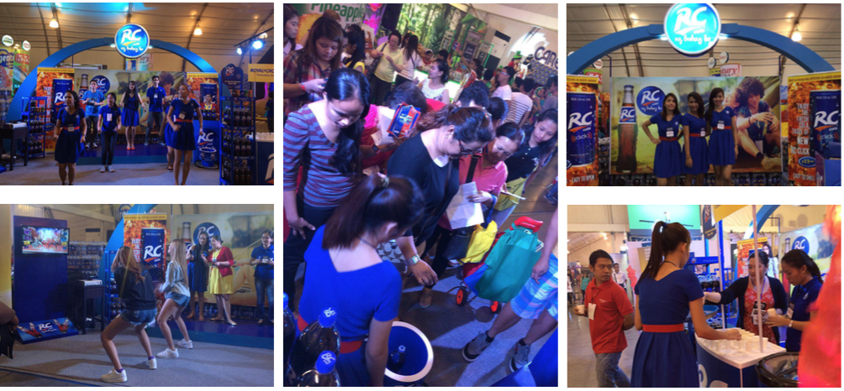
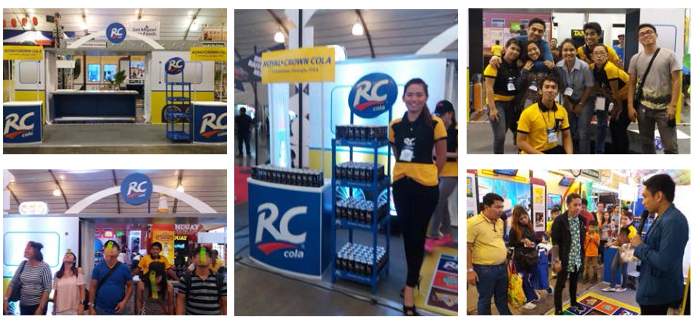
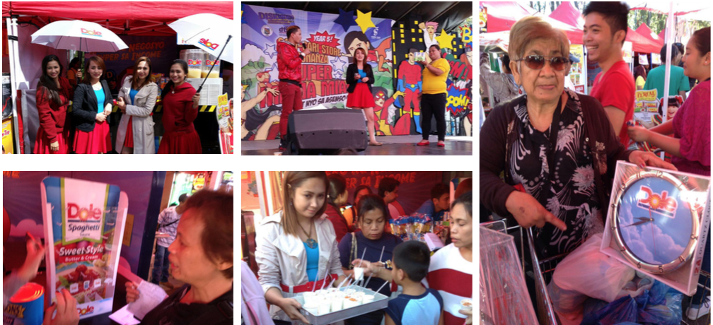
Event Concepts and Management RC UltraMega Convention (Oct 2015 & 2016)
WORKS
Notes:
Replace some pictures – tech booth
Corporate events
Including scriptwriting, video editing, screenshot on AVP

Slide 17
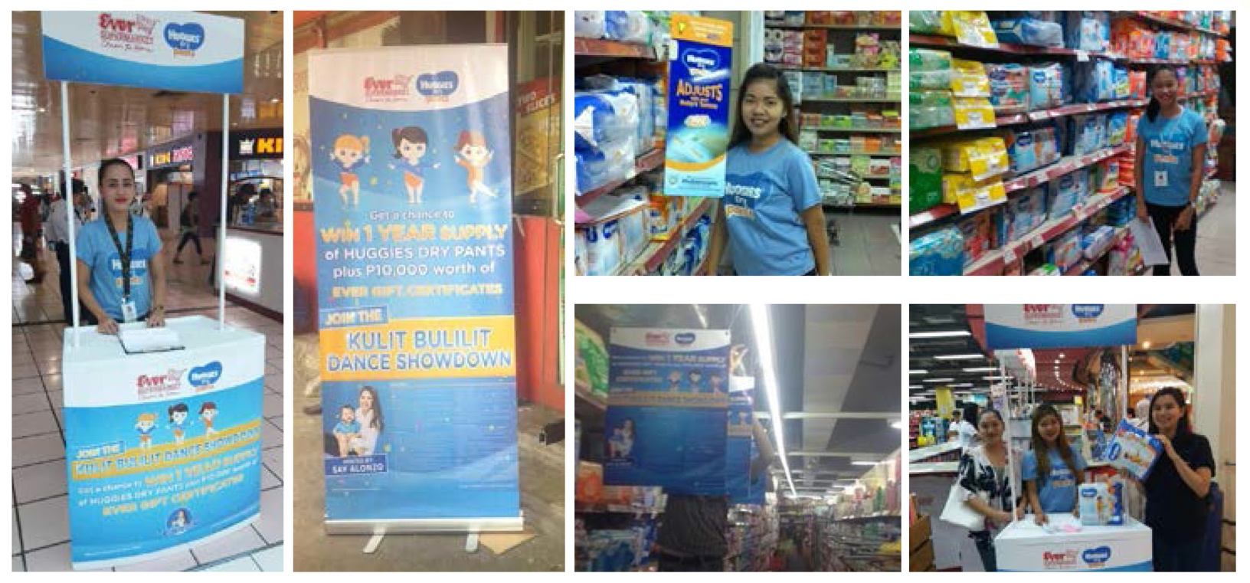
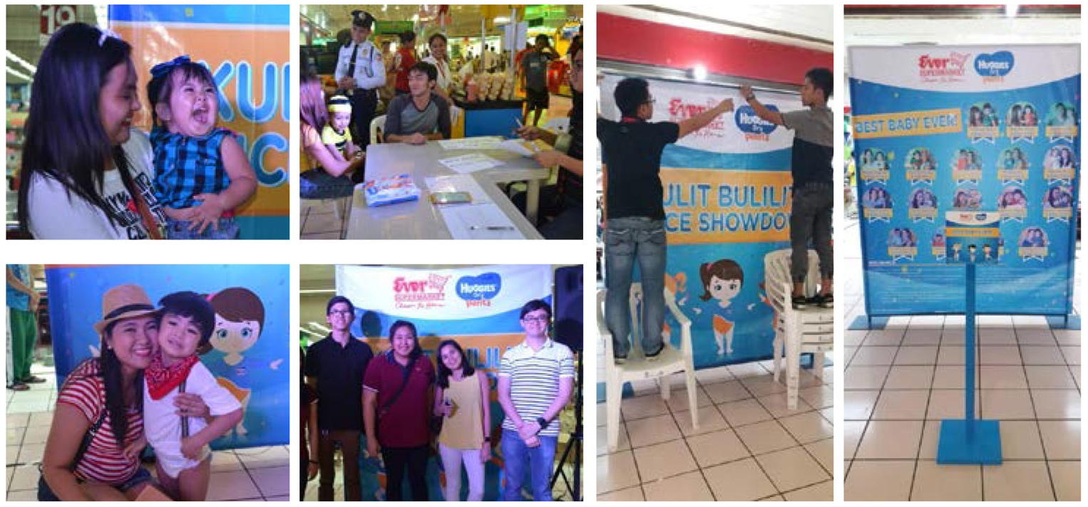
Event Concepts and Management Huggies Dry Pants Dance Showdown (Oct - Nov 2016)
WORKS
Notes:
Replace some pictures – tech booth
Corporate events
Including scriptwriting, video editing, screenshot on AVP

Slide 18
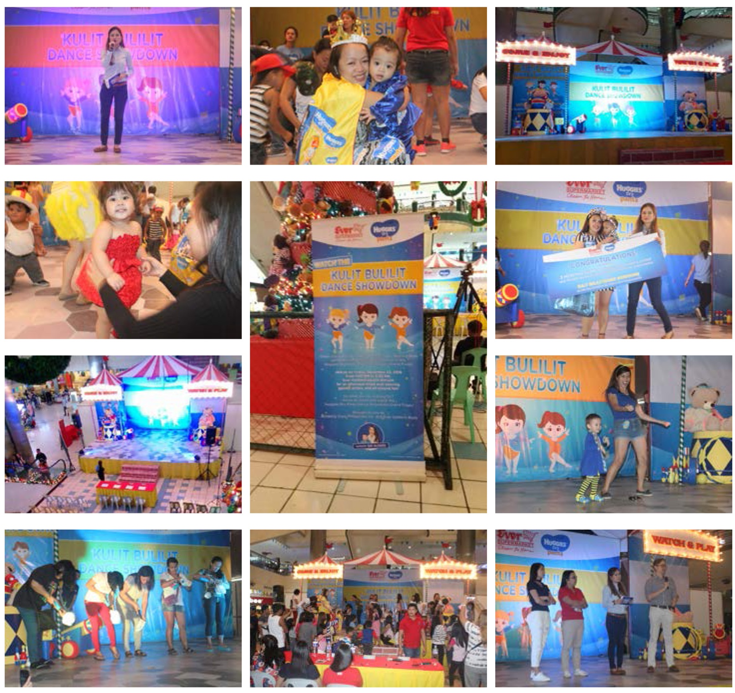
Event Concepts and Management Huggies Dry Pants Dance Showdown (Oct - Nov 2016)
WORKS
Notes:
Replace some pictures – tech booth
Corporate events
Including scriptwriting, video editing, screenshot on AVP

Slide 19
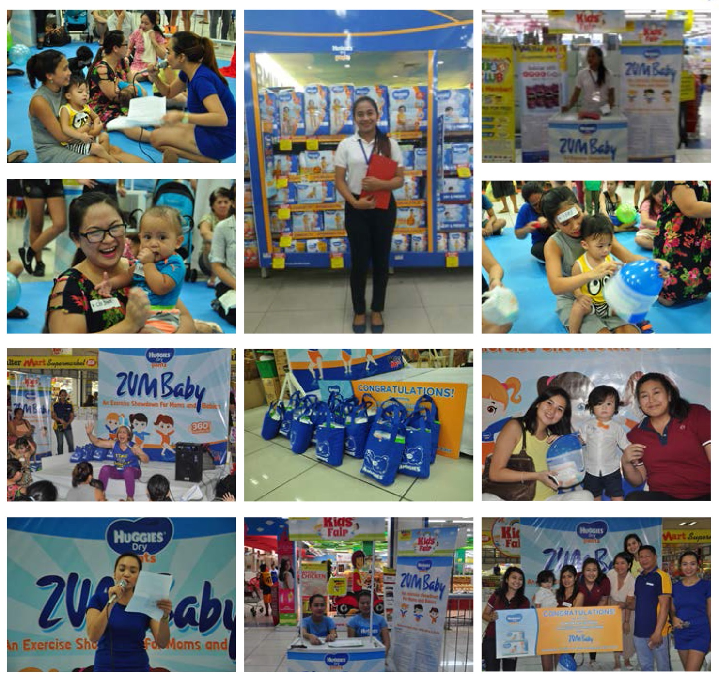
Event Concepts and Management Huggies Zumbaby Exercise Showdown (Oct 2016)
WORKS
Notes:
Replace some pictures – tech booth
Corporate events
Including scriptwriting, video editing, screenshot on AVP

Slide 20
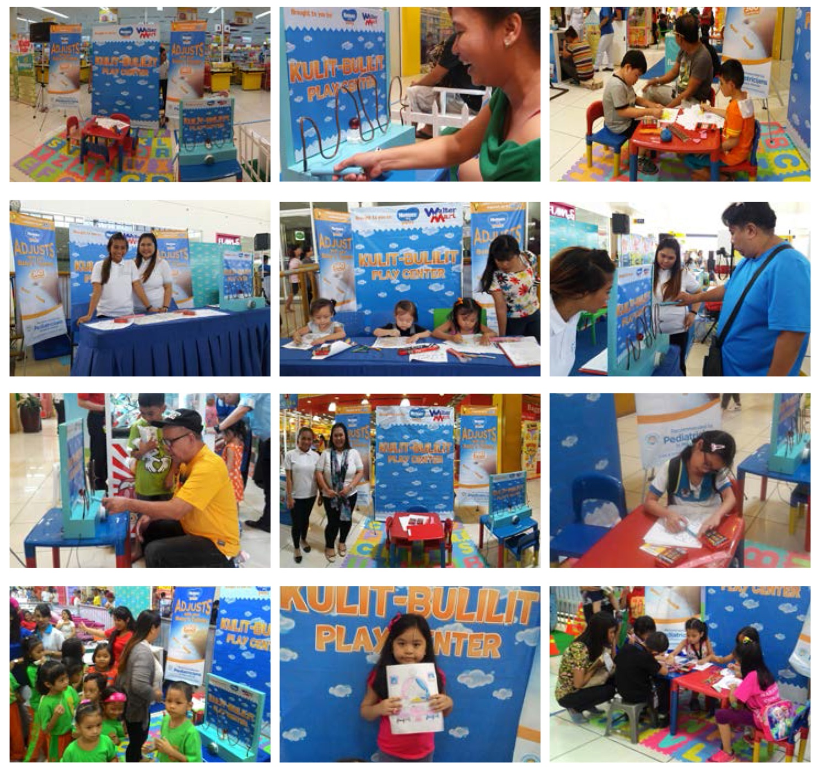
Event Concepts and Management Huggies Kid’s Fair Activation (Sept - Oct 2016)
WORKS
Notes:
Replace some pictures – tech booth
Corporate events
Including scriptwriting, video editing, screenshot on AVP

Slide 21
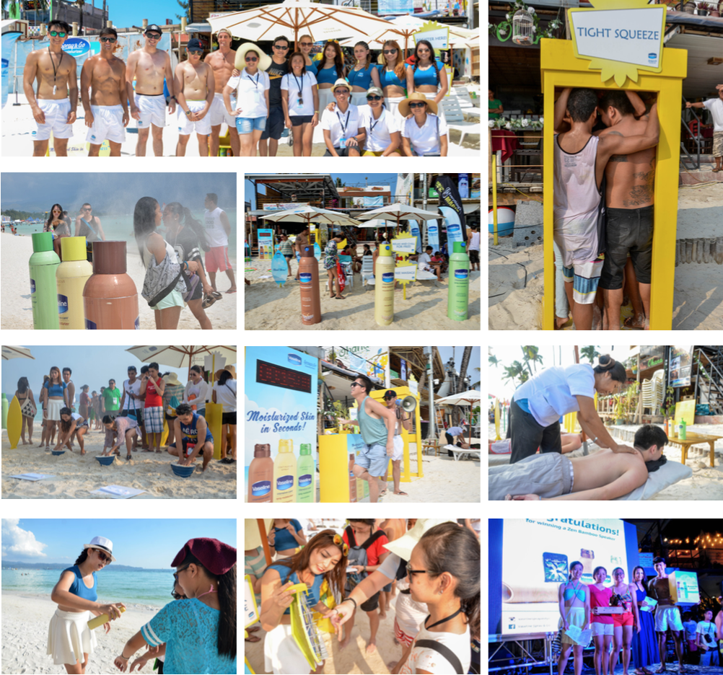
Event Concepts and Management Vaseline Spray & Go Labor Day Activation (April - May 2016)
WORKS
Notes:
Replace some pictures – tech booth
Corporate events
Including scriptwriting, video editing, screenshot on AVP

Slide 22
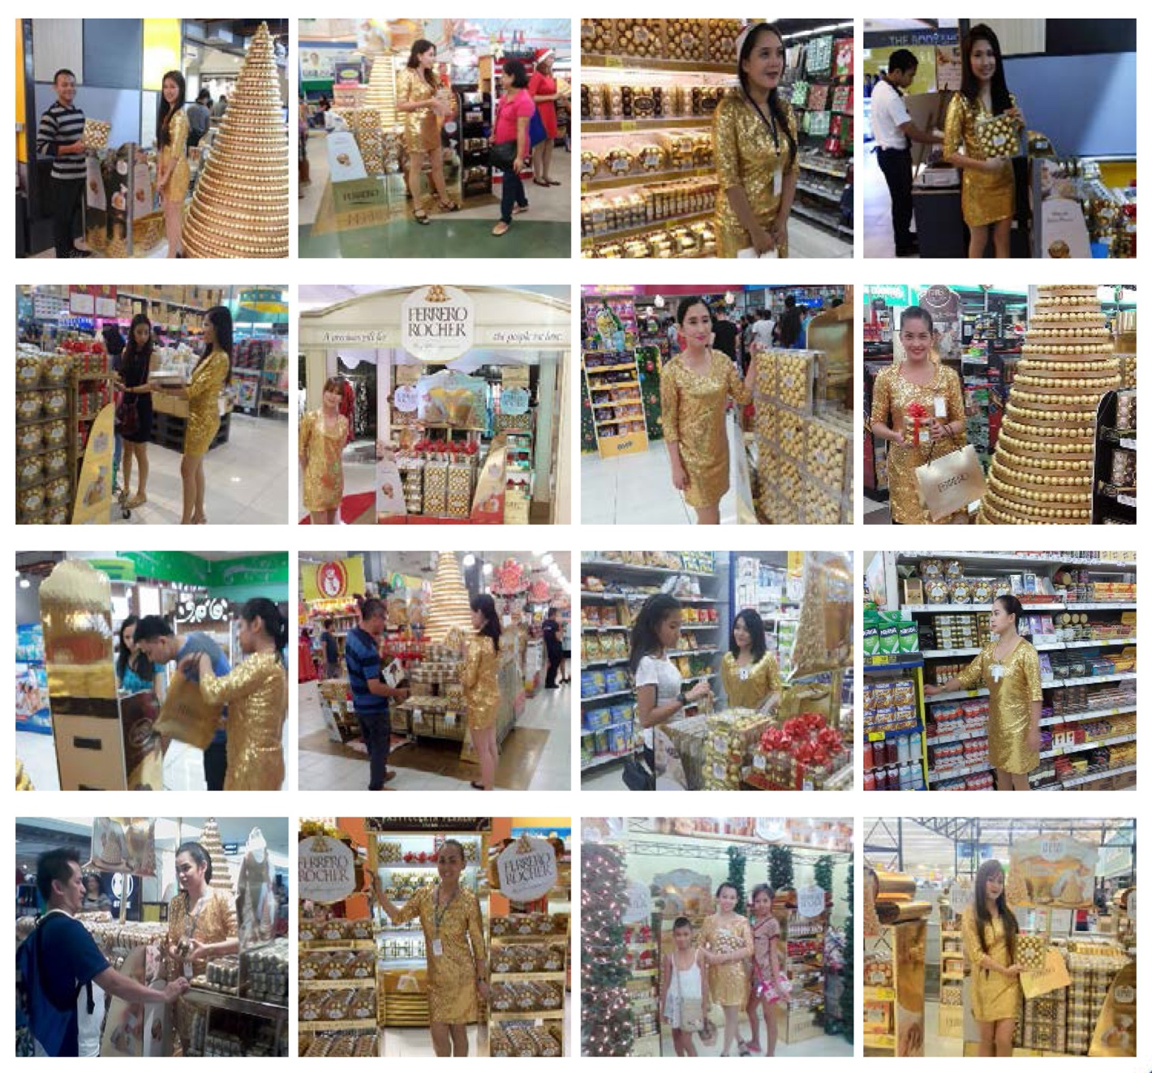
Brand and Product Activations Ferrero Rocher Christmas Push Selling (Dec 2016)
WORKS
Notes:
Replace some pictures – tech booth
Corporate events
Including scriptwriting, video editing, screenshot on AVP

Slide 23
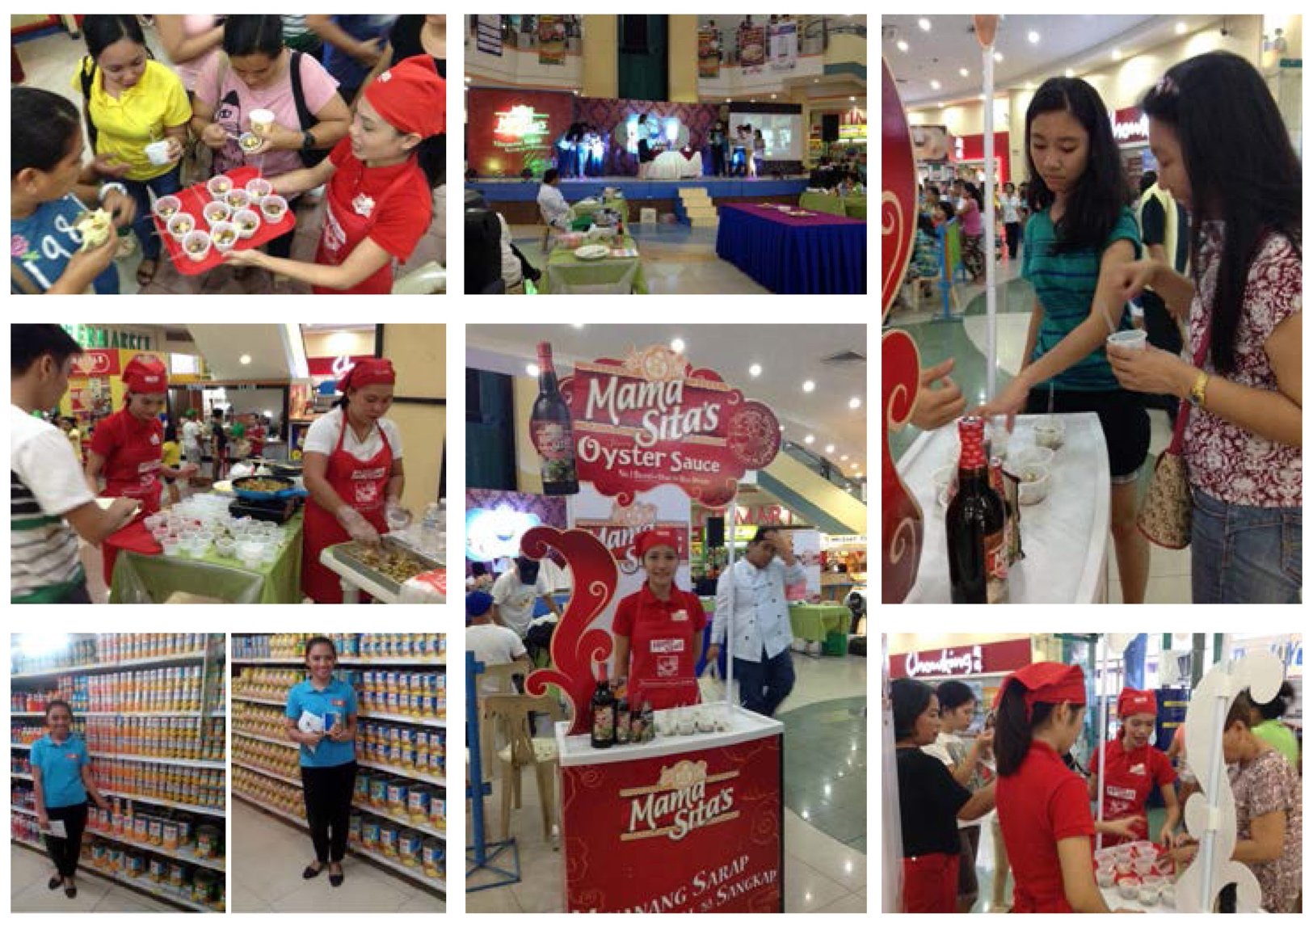
Brand and Product Activations Mama Sita’s Citimart Cookfest (Sept 2015) Dole Christmas Push Selling (Oct – Dec 2016)
WORKS
Notes:
Replace some pictures – tech booth
Corporate events
Including scriptwriting, video editing, screenshot on AVP

Slide 24
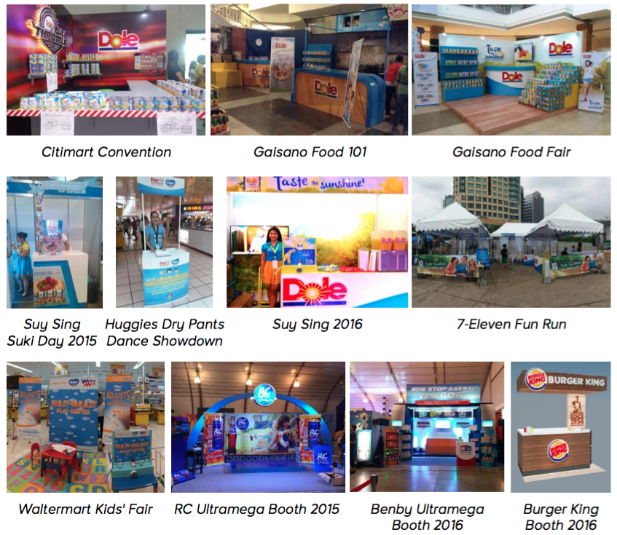
Creative Design and Concept Booth Designs (2015 to 2017)
WORKS
Notes:
Replace some pictures – tech booth
Corporate events
Including scriptwriting, video editing, screenshot on AVP

Slide 25
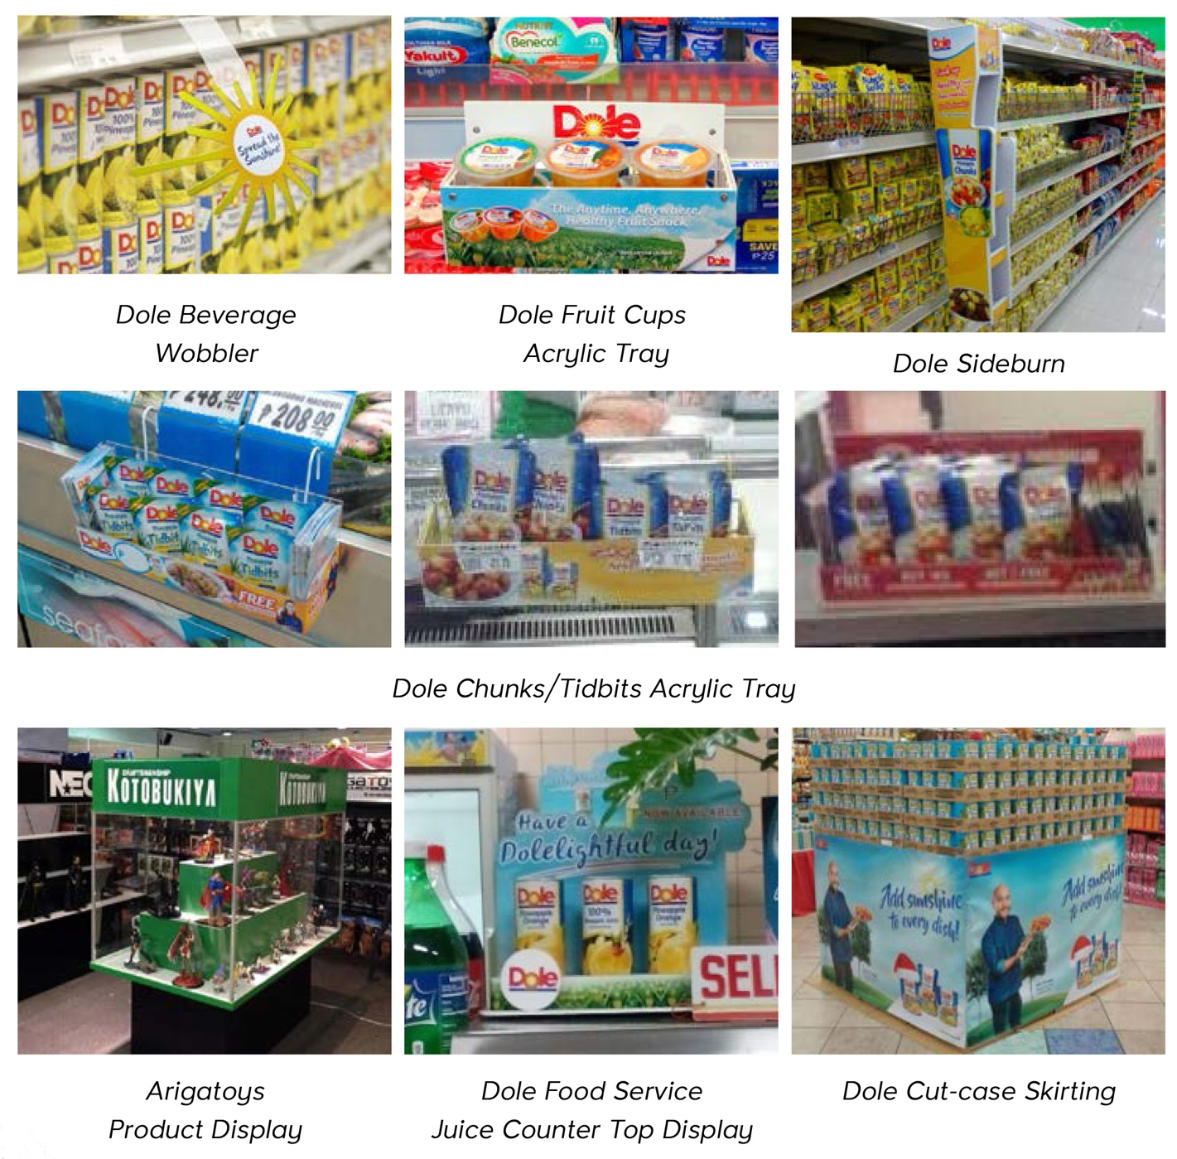
Fabrication, Merchandising & Product Displays In-Store Product Displays (2015 to 2017)
WORKS
Notes:
Replace some pictures – tech booth
Corporate events
Including scriptwriting, video editing, screenshot on AVP

Slide 26
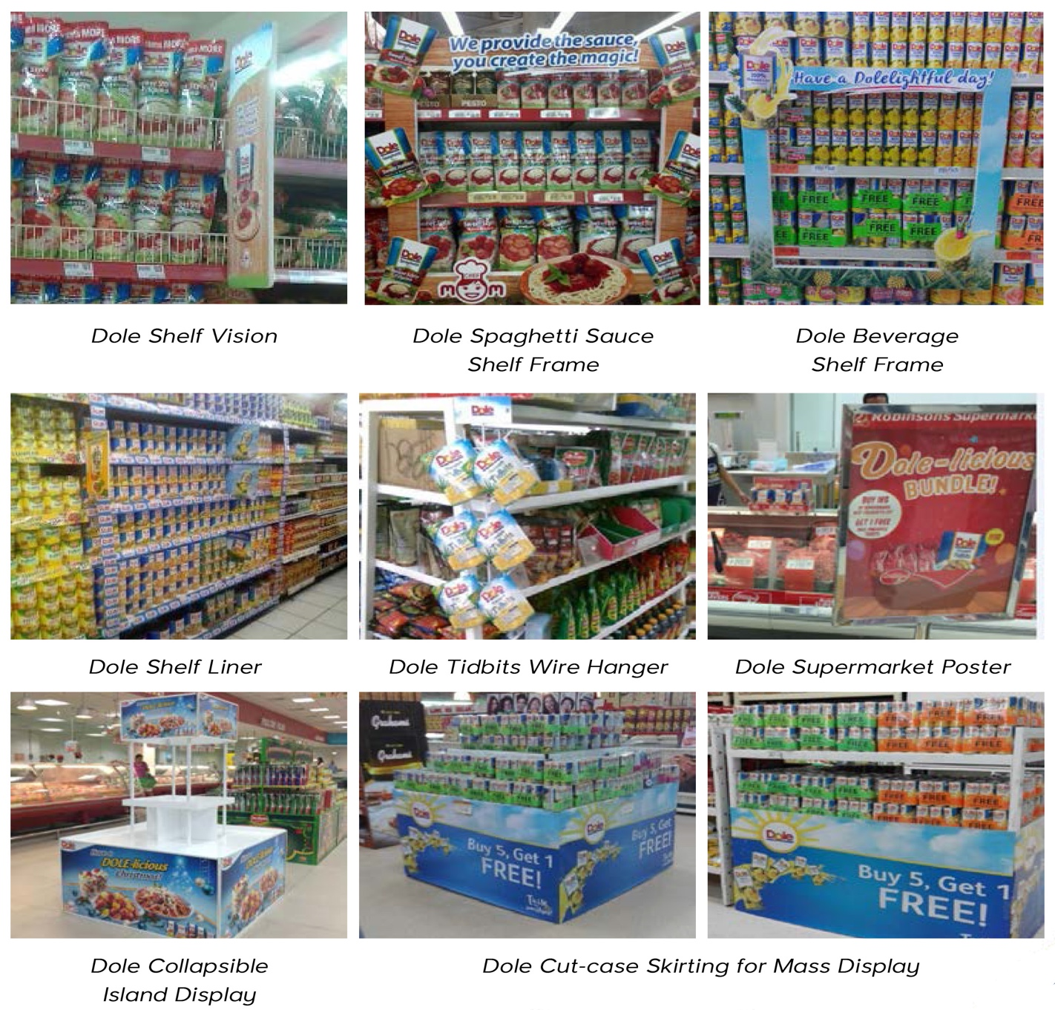
Fabrication, Merchandising & Product Displays In-Store Product Displays (2015 to 2017)
WORKS
Notes:
Replace some pictures – tech booth
Corporate events
Including scriptwriting, video editing, screenshot on AVP

Slide 27
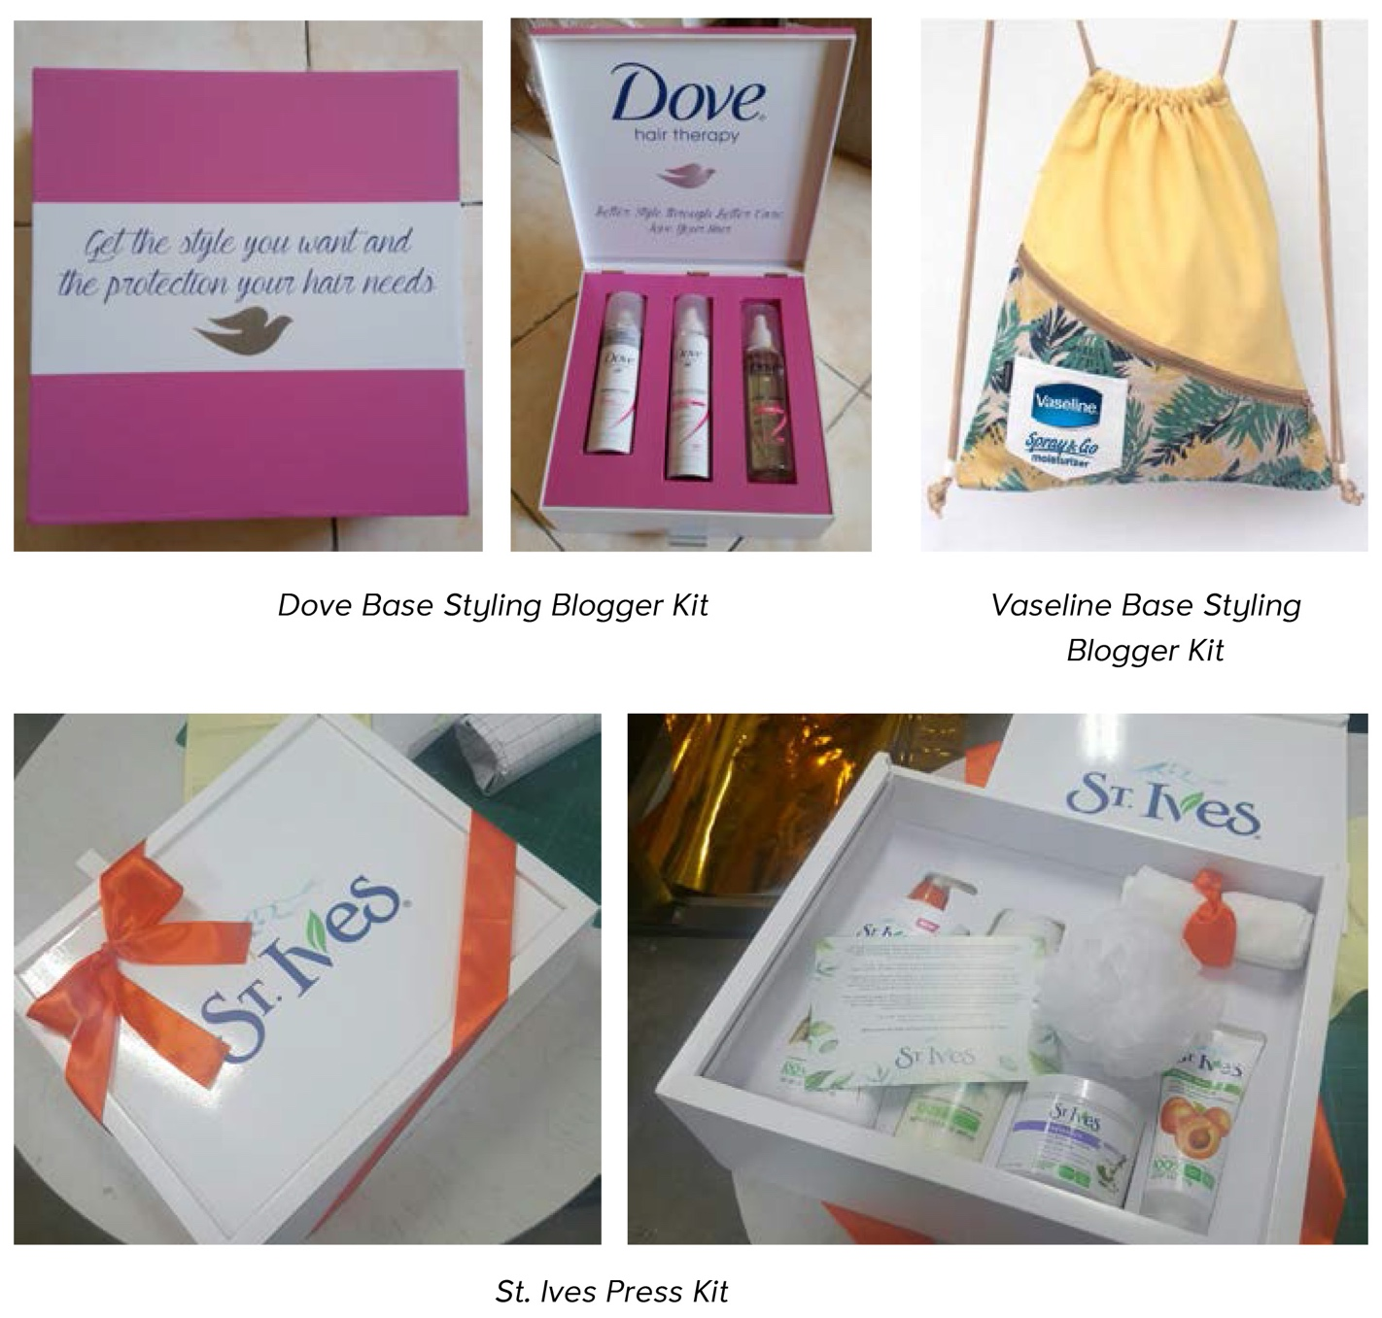
Fabrication, Merchandising & Product Displays PR Packages (2016)
WORKS
Notes:
Replace some pictures – tech booth
Corporate events
Including scriptwriting, video editing, screenshot on AVP

Slide 28
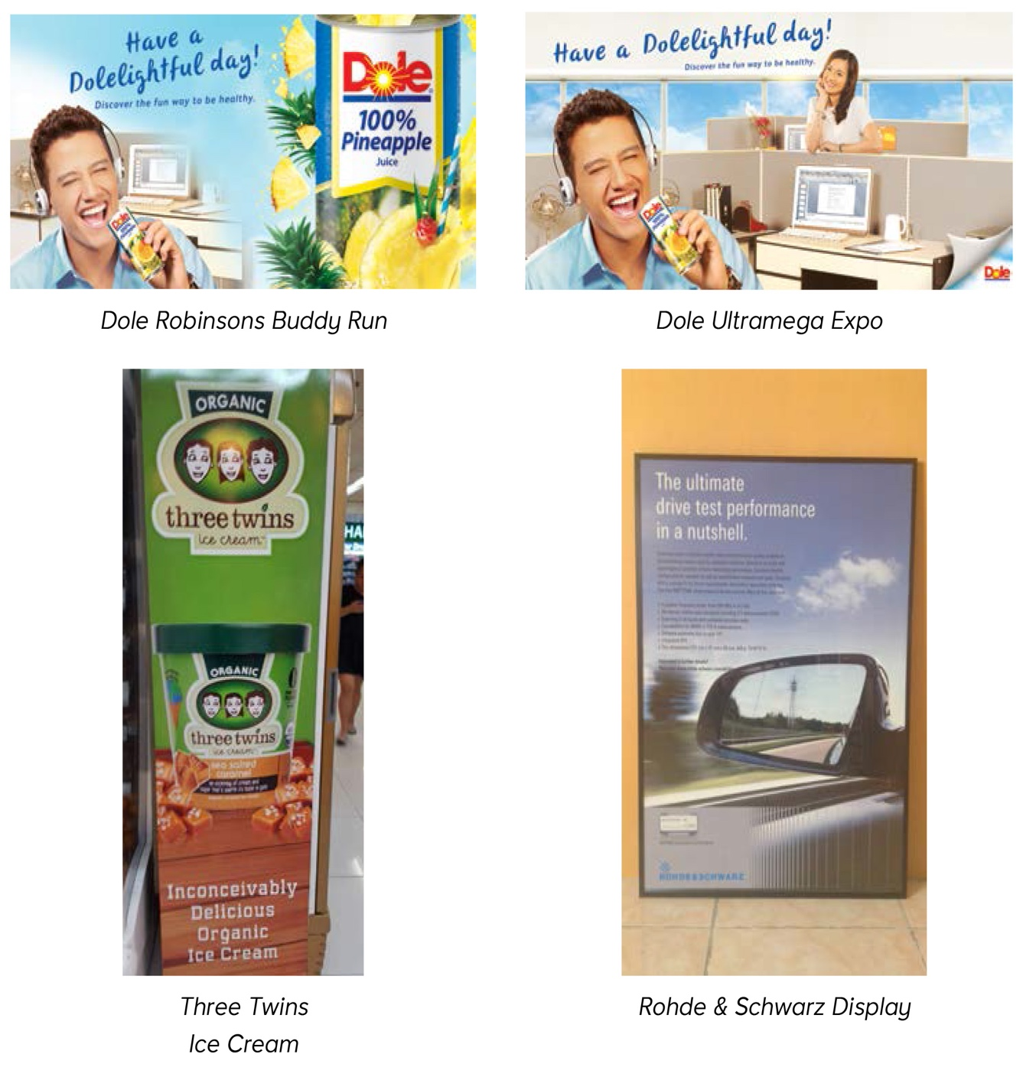
Printing and Installation From 2015 to 2017
WORKS
Perhaps include Travellers tarp here as well
Notes:
Replace some pictures – tech booth
Corporate events
Including scriptwriting, video editing, screenshot on AVP

Slide 29
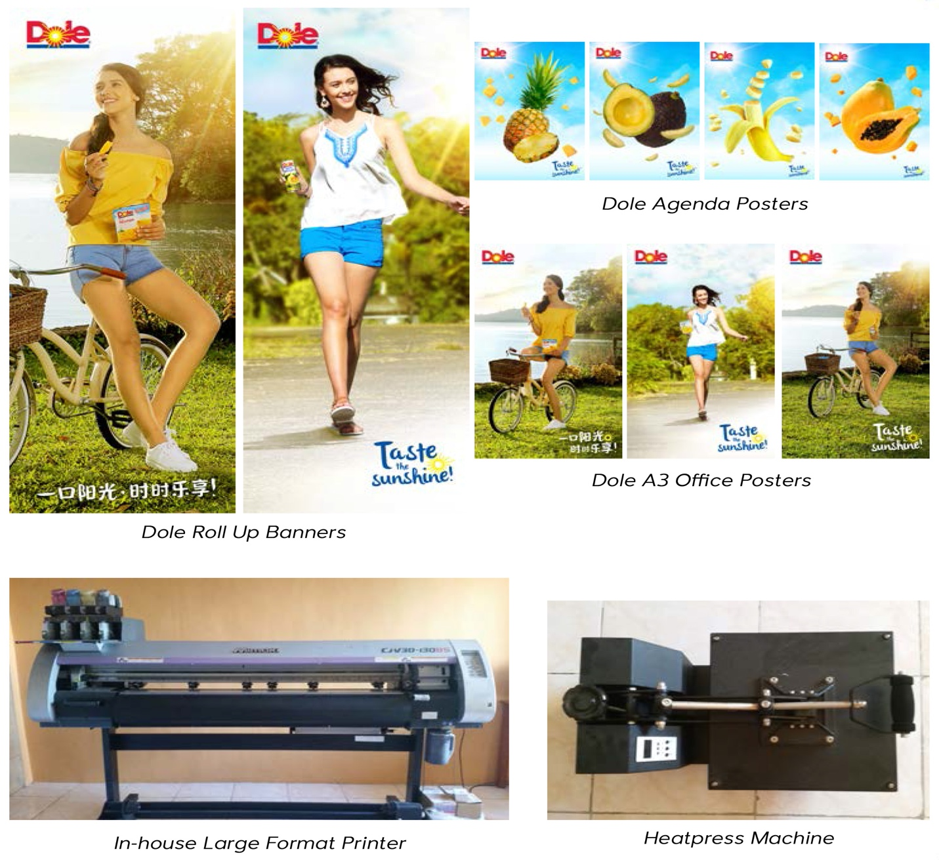
Printing and Installation From 2015 to 2017
WORKS
Notes:
Replace some pictures – tech booth
Corporate events
Including scriptwriting, video editing, screenshot on AVP

Slide 30
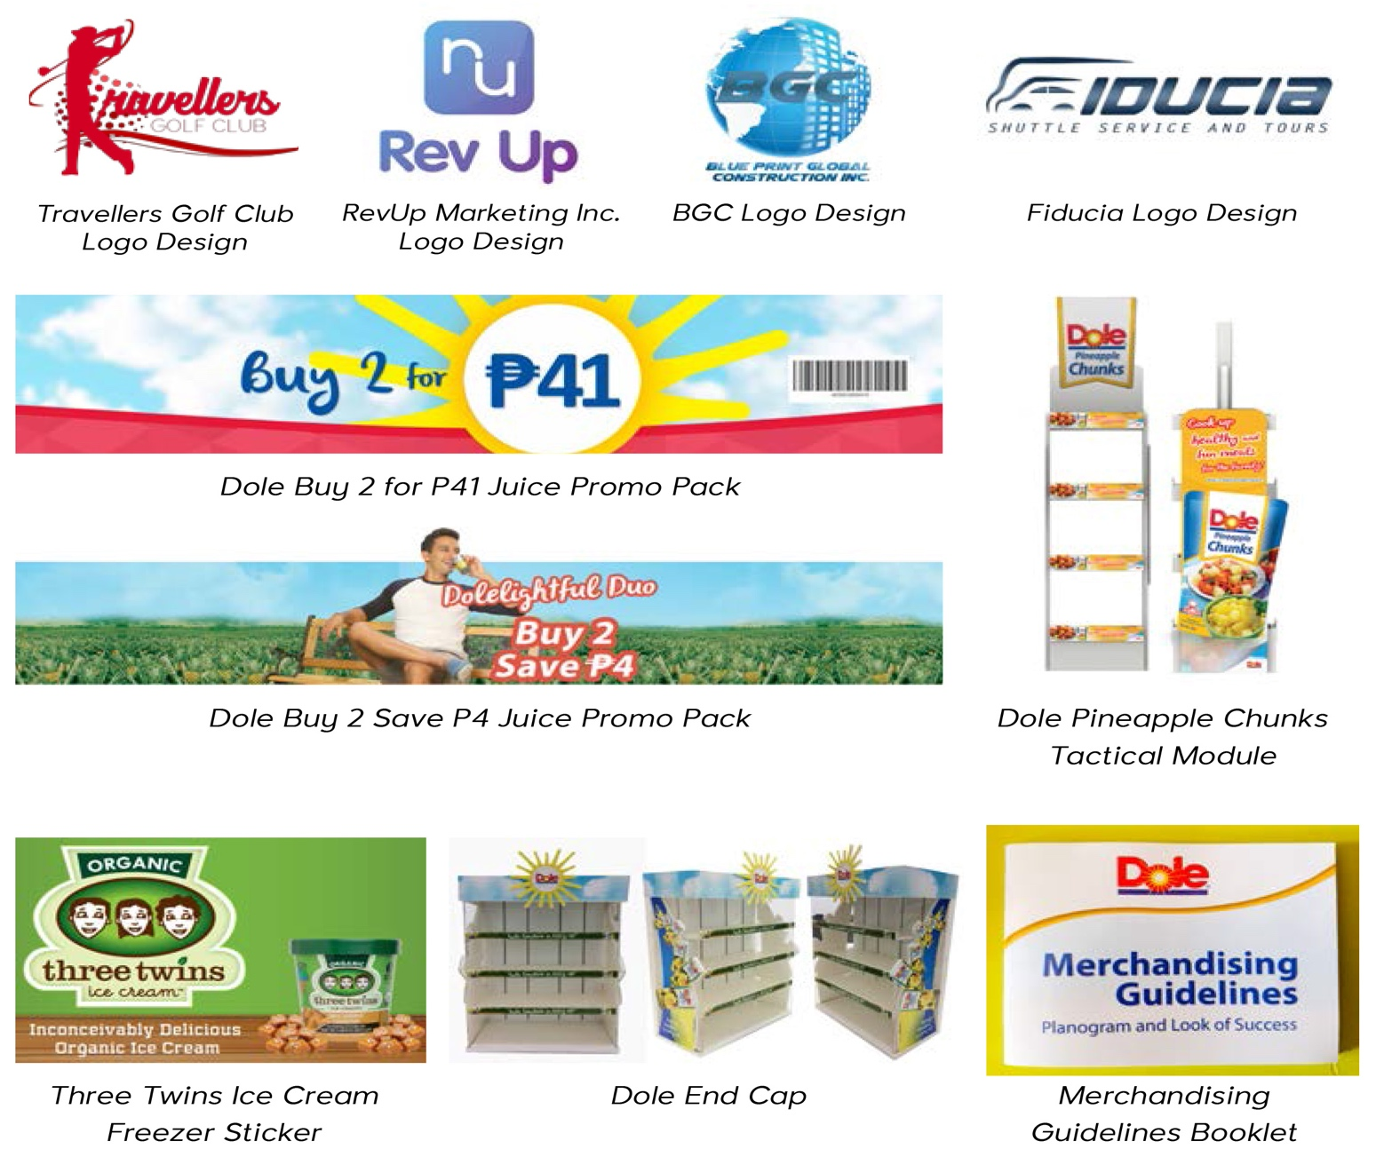
Creative Design and Concept Logo and Collateral Designs (2015 to 2017)
WORKS
Notes:
Replace some pictures – tech booth
Corporate events
Including scriptwriting, video editing, screenshot on AVP

Slide 31
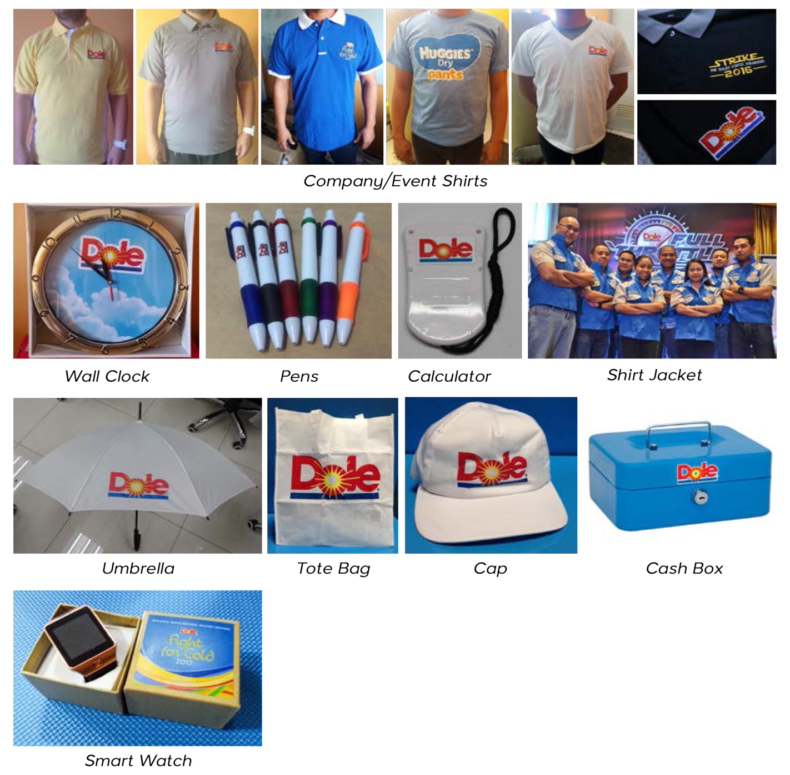
Corporate Giveaways and Premiums From 2015 to 2017
WORKS
Notes:
Replace some pictures – tech booth
Corporate events
Including scriptwriting, video editing, screenshot on AVP

Slide 32
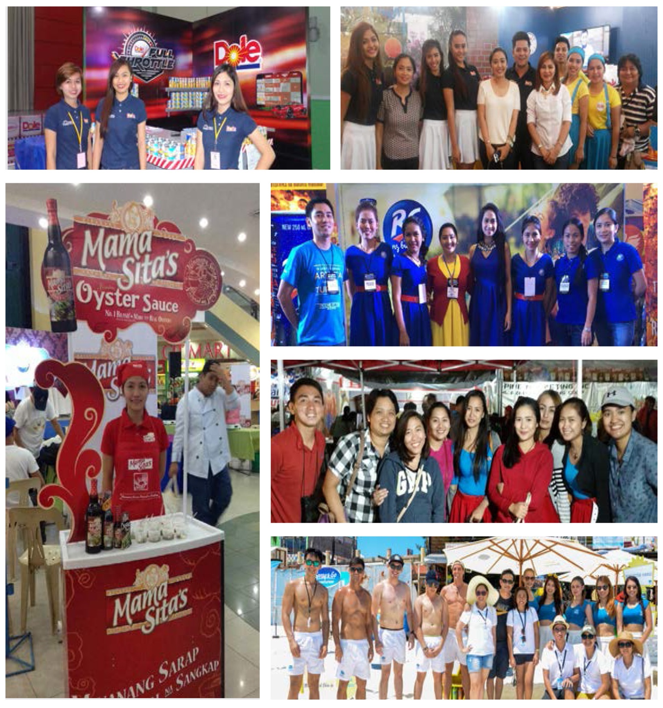
Manpower Services, Training and Development
WORKS
Notes:
Replace some pictures – tech booth
Corporate events
Including scriptwriting, video editing, screenshot on AVP

Slide 33
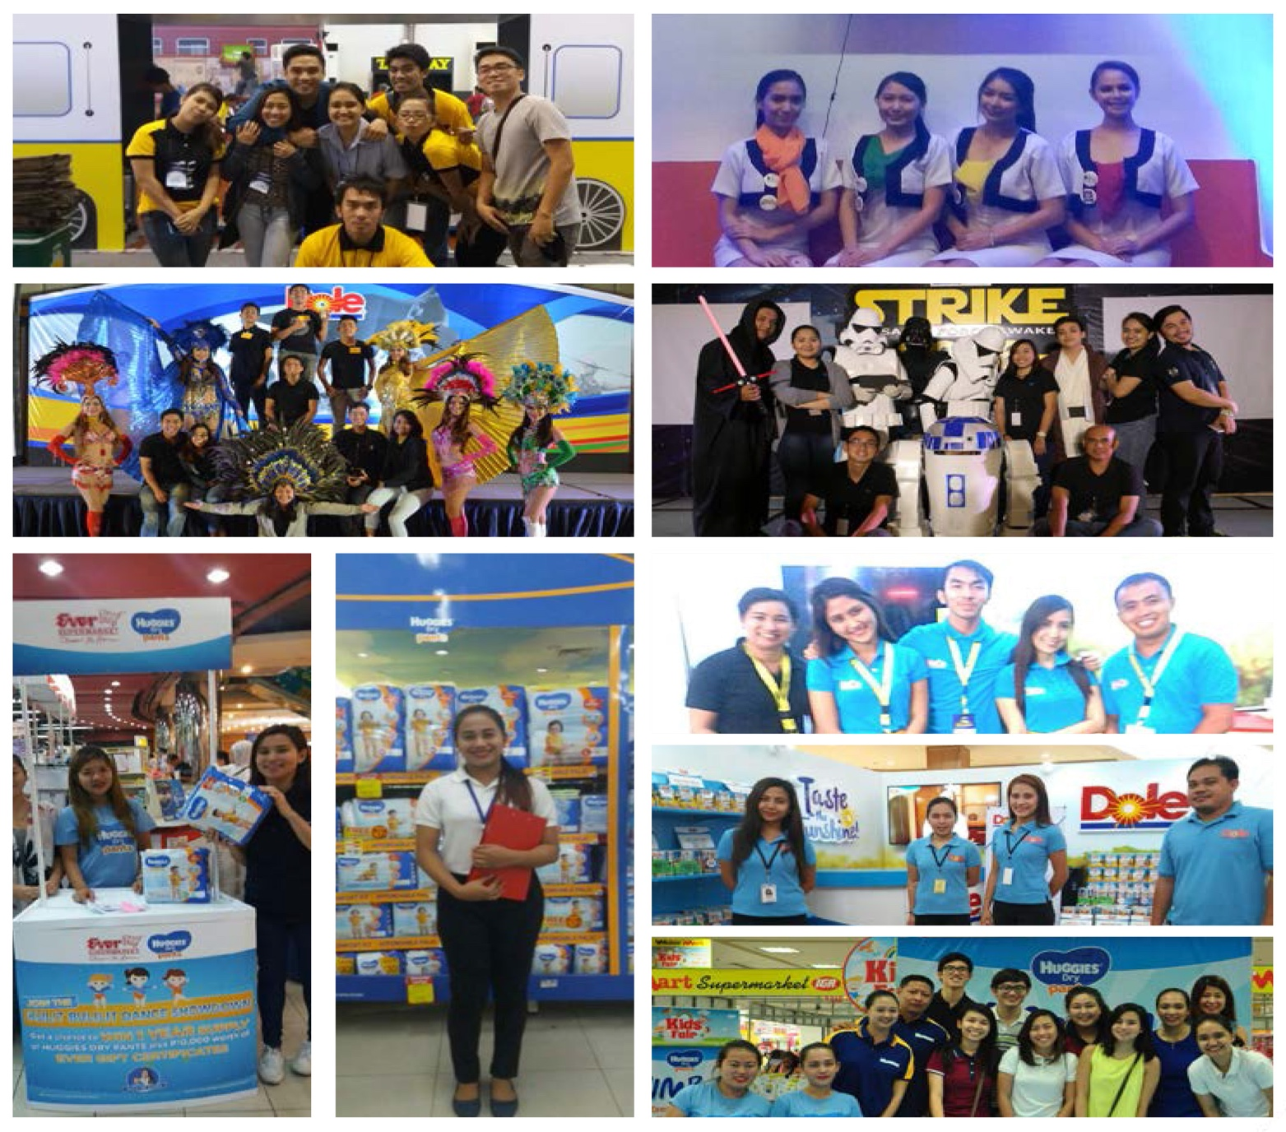
Manpower Services, Training and Development
WORKS
Notes:
Replace some pictures – tech booth
Corporate events
Including scriptwriting, video editing, screenshot on AVP

Slide 34

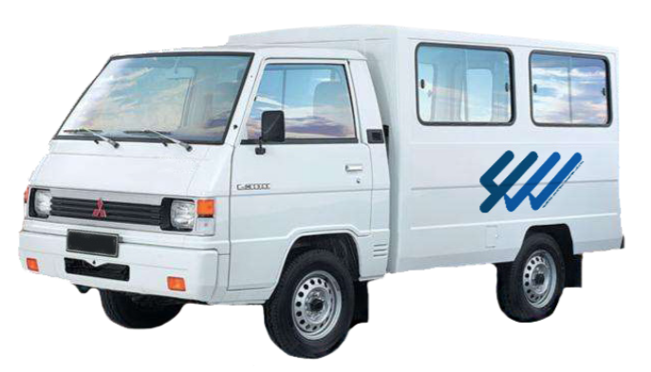
Selling & Jobber Programs Swift, Century Pacific Foods, Inc. (July 2015 – present)
WORKS
Objectives:
Grow monthly sales from 1MT to 3MT a year
Build census in Paranaque, Muntinlupa and Las Pinas
Achievements:
Average monthly sales hitting +16% vs target in 2015
Notes:
Replace some pictures – tech booth
Corporate events
Including scriptwriting, video editing, screenshot on AVP

Slide 35
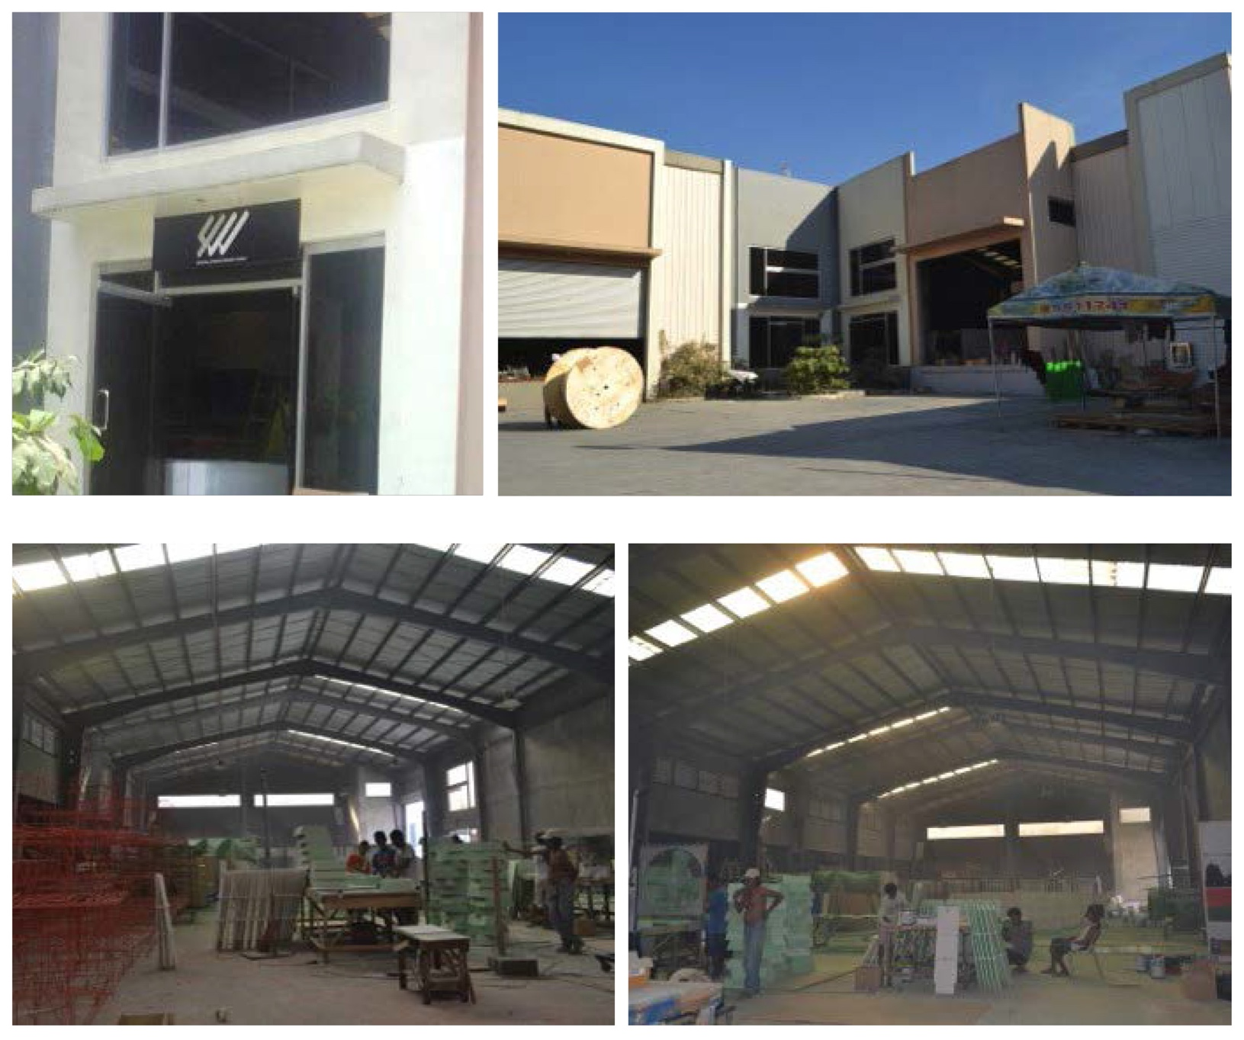
WAREHOUSE FACILITY
Ususan, Taguig

Slide 36
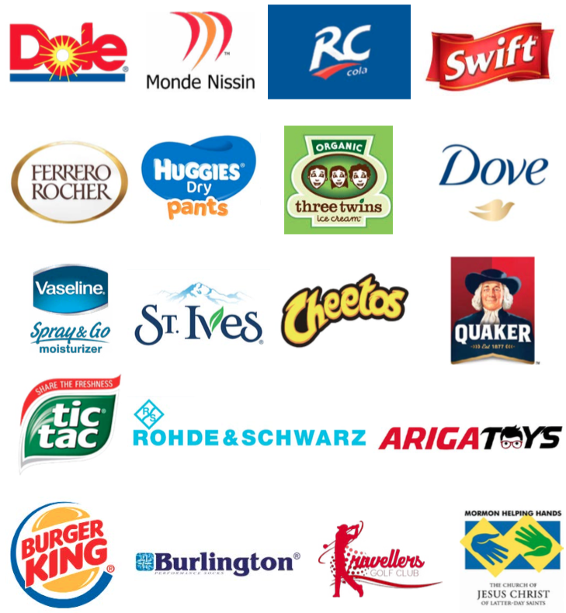
OUR CLIENTS

Slide 37
Work with us.
Let us know how we can work
WONDERS
with you.

